Slide 1
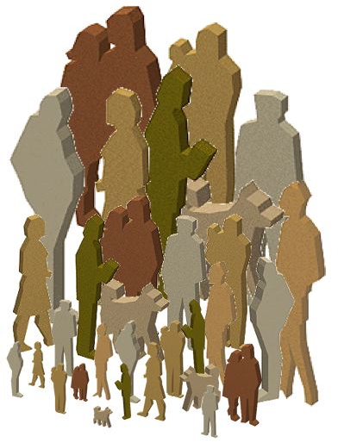

By
Rabia Sarwat

Slide 2

Sociology and society
Sociology is the systematic study of human society and social interaction.
A society is a large social group that shares same
geographical territory and that are the subject of same political authority and dominant cultural expectation.

Slide 3
Development of sociological thinking
Industrialization and urbanization
Global Interdependence
A relationship in which lives of all people are intertwined closely and any one nation’s problem are part of large global problem.
Sociological Imagination
The ability to see relationship between individual experiences and the large society.

Slide 4
Contemporary theoretical perspective
Theory is a set of logically interrelated statements that attempts to describe, explain and predict social event.

Slide 5
Functionalist perspective
Functionalist perspectives are based on the assumption that society is stable , orderly system.
Famous name: Talcott parson and Robert merton. Merton gave concept of manifest function and latent function.
Manifest function that are overtly recognized by participant in a social unit.
Latent function are unintended that are hidden and unacknowledged by participant.

Slide 6
Conflict perspective
Conflict perspective , group in a society that are engaged in a continuous power struggle.
Famous names: Max Weber and C. Wright Mills.
Karl Marks focused on the exploitation and oppression of proletariat by the bourgeoisie.
Max Weber recognized importance of economic conditions in producing inequality and conflict in society.

Slide 7
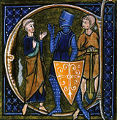
Conflict perspective
Conflict perspective has several branches:
First branch Neo-Marxist approach view struggle between classes as a prime source of social change.
Second branch focuses on racial ethnic inequalities and exploitation of members of some racial ethnic group.
Third branch Feminist perspective focuses on gender issues.

Slide 8
Contin
Feminist approach:
Feminist approach directs attention to women’s experience and the importance of gender as an element of social structure.
According to feminism we live patriarchy, a system in which man dominates woman.
Symbolic interactions perspective the sociological approach that view society as the sum of individual and group.
Symbolic interactionist approaches are based on a micro level analysis. It focuses on small groups rather then large scales social structure.
Post modern theory is based on the assumption that social changes occur as societies move from modern to post modern.

